Slide 1

Chapter 2
Network Models
2.<number>
Copyright © The McGraw-Hill Companies, Inc. Permission required for reproduction or display.

Slide 2
2-1 LAYERED TASKS
We use the concept of layers in our daily life. As an example, let us consider two friends who communicate through postal mail. The process of sending a letter to a friend would be complex if there were no services available from the post office.
Topics discussed in this section:
Sender, Receiver, and Carrier
Hierarchy
2.<number>

Slide 3

Figure 2.1 Tasks involved in sending a letter
2.<number>

Slide 4
2-2 THE OSI MODEL
Established in 1947, the International Standards Organization (ISO) is a multinational body dedicated to worldwide agreement on international standards. An ISO standard that covers all aspects of network communications is the Open Systems Interconnection (OSI) model. It was first introduced in the late 1970s.
Topics discussed in this section:
Layered Architecture
Peer-to-Peer Processes
Encapsulation
2.<number>

Slide 5

Note
ISO is the organization.
OSI is the model.
2.<number>

Slide 6

Figure 2.2 Seven layers of the OSI model
2.<number>

Slide 7

Figure 2.3 The interaction between layers in the OSI model
2.<number>

Slide 8

Figure 2.4 An exchange using the OSI model
2.<number>

Slide 9
2-3 LAYERS IN THE OSI MODEL
In this section we briefly describe the functions of each layer in the OSI model.
Topics discussed in this section:
Physical Layer
Data Link Layer
Network Layer
Transport Layer
Session Layer
Presentation Layer
Application Layer
2.<number>

Slide 10

Figure 2.5 Physical layer
2.<number>

Slide 11
Note
The physical layer is responsible for movements of
individual bits from one hop (node) to the next.
Functions of a Physical layer:
Line Configuration: It defines the way how two or more devices can be connected physically.
Data Transmission: It defines the transmission mode whether it is simplex, half-duplex or full-duplex mode between the two devices on the network.
Topology: It defines the way how network devices are arranged.
Signals: It determines the type of the signal used for transmitting the information.
2.<number>

Slide 12

Figure 2.6 Data link layer
2.<number>

Slide 13
The data link layer is responsible for moving
frames from one hop (node) to the next.
Functions of the Data-link layer
Framing: The data link layer translates the physical's raw bit stream into packets known as Frames..
Physical Addressing: The Data link layer adds a header to the frame that contains a destination address. The frame is transmitted to the destination address mentioned in the header.
Flow Control: Flow control is the main functionality of the Data-link layer. It is the technique through which the constant data rate is maintained on both the sides so that no data get corrupted.
Error Control: Error control is achieved by adding a calculated value CRC (Cyclic Redundancy Check) that is placed to the Data link layer's trailer which is added to the message frame before it is sent to the physical layer
Access Control: When two or more devices are connected to the same communication channel, then the data link layer protocols are used to determine which device has control over the link at a given time.
2.<number>

Slide 14

Figure 2.7 Hop-to-hop delivery
2.<number>

Slide 15

Figure 2.8 Network layer
2.<number>

Slide 16
The network layer is responsible for the
delivery of individual packets from
the source host to the destination host.
Internetworking: An internetworking is the main responsibility of the network layer. It provides a logical connection between different devices.
Addressing: A Network layer adds the source and destination address to the header of the frame. Addressing is used to identify the device on the internet.
Routing: Routing is the major component of the network layer, and it determines the best optimal path out of the multiple paths from source to the destination.
Packetizing: A Network Layer receives the packets from the upper layer and converts them into packets. This process is known as Packetizing. It is achieved by internet protocol (IP).
2.<number>

Slide 17

Figure 2.9 Source-to-destination delivery
2.<number>

Slide 18

Figure 2.10 Transport layer
2.<number>

Slide 19
The transport layer is responsible for the delivery
of a message from one process to another.
Service-Point Addressing
Segmentation and Reassembly
Connection Control
Flow control
Error control
2.<number>

Slide 20

Figure 2.11 Reliable process-to-process delivery of a message
2.<number>

Slide 21

Figure 2.12 Session layer
2.<number>

Slide 22
The session layer is responsible for dialog
control and synchronization.
Dialog control: Session layer acts as a dialog controller that creates a dialog between two processes or we can say that it allows the communication between two processes which can be either half-duplex or full-duplex.
Synchronization: Session layer adds some checkpoints when transmitting the data in a sequence. If some error occurs in the middle of the transmission of data, then the transmission will take place again from the checkpoint. This process is known as Synchronization and recovery.
2.<number>

Slide 23

Figure 2.13 Presentation layer
2.<number>

Slide 24
Note
The presentation layer is responsible for translation, compression, and encryption.
2.<number>

Slide 25

Figure 2.14 Application layer
2.<number>

Slide 26
Note
The application layer is responsible for
providing services to the user.
2.<number>

Slide 27

Figure 2.15 Summary of layers
2.<number>

Slide 28
2-4 TCP/IP PROTOCOL SUITE
The layers in the TCP/IP protocol suite do not exactly match those in the OSI model. The original TCP/IP protocol suite was defined as having four layers: host-to-network, internet, transport, and application. However, when TCP/IP is compared to OSI, we can say that the TCP/IP protocol suite is made of five layers: physical, data link, network, transport, and application.
Topics discussed in this section:
Physical and Data Link Layers
Network Layer
Transport Layer
Application Layer
2.<number>

Slide 29

Figure 2.16 TCP/IP and OSI model
2.<number>

Slide 30
NETWORK LAYER
ICMP- Internet Control Message Protocol
It is an error-reporting protocol that network devices such as routers use to generate error messages to the source IP address when network problems prevent delivery of IP packets.
IGMP – Internet Gateway Message Protocol
The Internet Group Management Protocol (IGMP) is a protocol that allows several devices to share one IP address so they can all receive the same data.
RARP
Reverse Address Resolution Protocol (RARP) is a protocol a physical machine in a local area network (LAN) can use to request its IP address
ARP
Address Resolution Protocol (ARP) is a protocol or procedure that connects an ever-changing Internet Protocol (IP) address to a fixed physical machine address, also known as a media access control (MAC) address, in a local-area network (LAN).
2.<number>

Slide 31
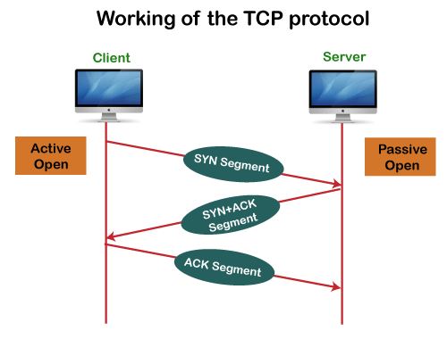
TRANSPORT LAYER
Stream Control Transmission Protocol (SCTP) is a transport-layer protocol that ensures reliable, in-sequence transport of data. SCTP provides multihoming support where one or both endpoints of a connection can consist of more than one IP address.
Transmission Control Protocol (TCP) is a communications standard that enables application programs and computing devices to exchange messages over a network. It is designed to send packets across the internet and ensure the successful delivery of data and messages over networks.
2.<number>

Slide 32
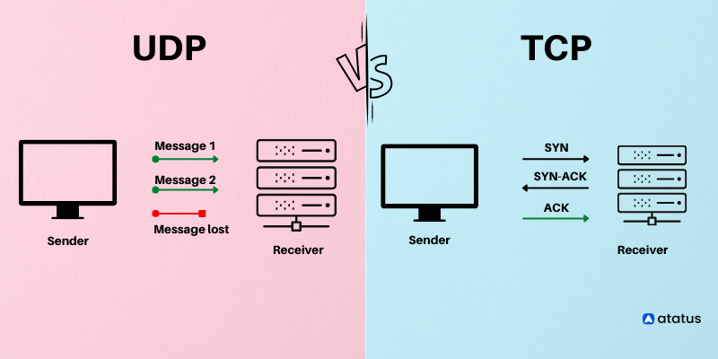
User Datagram Protocol (UDP) refers to a protocol used for communication throughout the internet. It is specifically chosen for time-sensitive applications like gaming, playing videos, or Domain Name System (DNS) lookups.
2.<number>

Slide 33
2-5 ADDRESSING
Four levels of addresses are used in an internet employing the TCP/IP protocols: physical, logical, port, and specific.
Topics discussed in this section:
Physical Addresses
Logical Addresses
Port Addresses
Specific Addresses
2.<number>

Slide 34

Figure 2.17 Addresses in TCP/IP
2.<number>

Slide 35

Figure 2.18 Relationship of layers and addresses in TCP/IP
2.<number>

Slide 36
Example 2.1
In Figure 2.19 a node with physical address 10 sends a frame to a node with physical address 87. The two nodes are connected by a link (bus topology LAN). As the figure shows, the computer with physical address 10 is the sender, and the computer with physical address 87 is the receiver.
2.<number>

Slide 37

Figure 2.19 Physical addresses
2.<number>

Slide 38
Example 2.2
Most local-area networks use a 48-bit (6-byte) physical address written as 12 hexadecimal digits; every byte (2 hexadecimal digits) is separated by a colon, as shown below:
07:01:02:01:2C:4B
A 6-byte (12 hexadecimal digits) physical address.
2.<number>

Slide 39
Example 2.3
Figure 2.20 shows a part of an internet with two routers connecting three LANs. Each device (computer or router) has a pair of addresses (logical and physical) for each connection. In this case, each computer is connected to only one link and therefore has only one pair of addresses. Each router, however, is connected to three networks (only two are shown in the figure). So each router has three pairs of addresses, one for each connection.
2.<number>

Slide 40

Figure 2.20 IP addresses
2.<number>

Slide 41
Example 2.4
Figure 2.21 shows two computers communicating via the Internet. The sending computer is running three processes at this time with port addresses a, b, and c. The receiving computer is running two processes at this time with port addresses j and k. Process a in the sending computer needs to communicate with process j in the receiving computer. Note that although physical addresses change from hop to hop, logical and port addresses remain the same from the source to destination.
2.<number>

Slide 42

Figure 2.21 Port addresses
2.<number>

Slide 43
Note
The physical addresses will change from hop to hop,
but the logical addresses usually remain the same.
2.<number>

Slide 44
Example 2.5
A port address is a 16-bit address represented by one decimal number as shown.
753
A 16-bit port address represented
as one single number.
2.<number>

